Slide 1









CATCH ME
IF YOU CAN

Slide 2


ABOUT GAME
"Catch Me If You Can" is an immersive game set in a dynamic world of mystery and adventure. Players navigate through obstacles while pursuing an elusive target, using wit, strategy, and reflexes to outsmart opponents. With stunning visuals, engaging gameplay "Catch Me If You Can" offers a unique experience. From exploring hidden passages to engaging in intense chases, every moment is filled with excitement. With its blend of action, strategy, and storytelling, the game promises endless entertainment for players of all ages. Are you ready to embark on this thrilling journey? Join the chase in "Catch Me If You Can" and experience the excitement firsthand!

Slide 3



DESIGN CHOICES
1.Programming Language: Python was selected for its simplicity, readability, and rapid development capabilities.
2. Game Development Library: Pygame was chosen as it offers a robust set of tools for creating 2D games in Python, including graphics, sound, and input handling.
3. Platform: The game will be developed for desktop platforms to ensure broad accessibility and simplify distribution and deployment.
4. 2D Graphics: Opting for 2D graphics allows for engaging visuals and immersive gameplay experiences without the complexity of 3D graphics, enabling a focus on gameplay mechanics.
5. Accessibility: Developing for desktop platforms ensures that the game can be played on a wide range of devices, including laptops and desktop computers, maximizing accessibility for players.

Slide 4
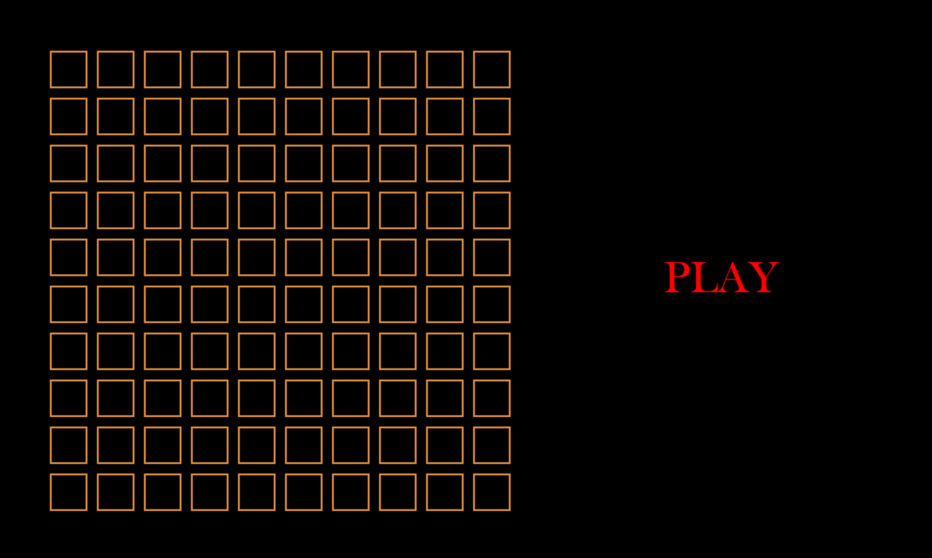
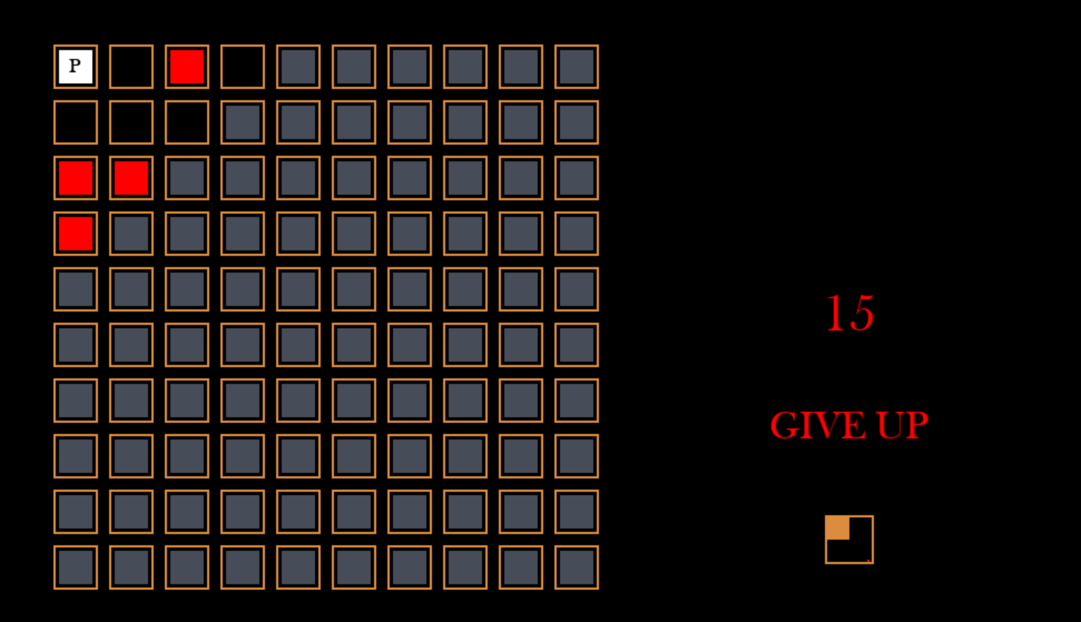
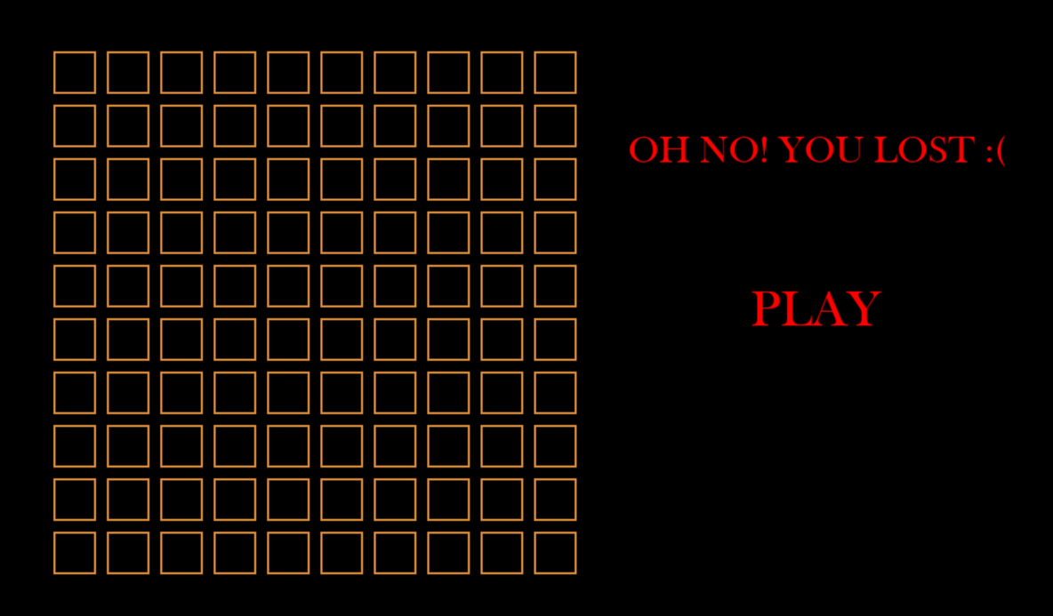
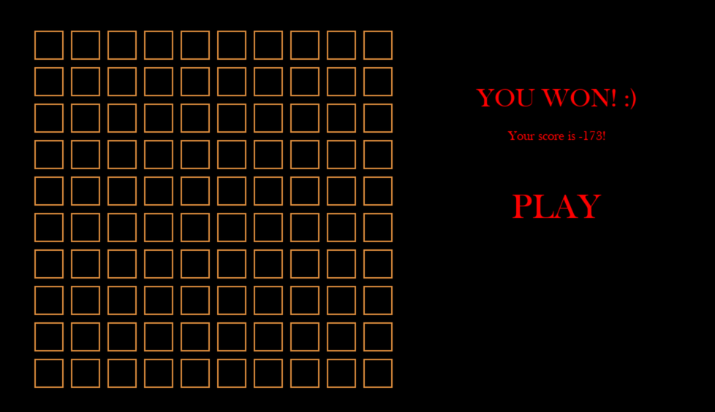
OUR PLATFORM

Slide 5

GAME CONTROLS
PLAYER CONTROLS
THE PLAYER MOVES USING
THE TRADITIONAL ARROW KEYS
CAMERA CONTROLS
THE CAMERA MOVES USING THE
WASD CONFIGURATION.
PRESS EITHER SHIFT BUTTON FOR
AN EXCITING SURPRISE!
BLAST!

Slide 6


GAME RULES
01
Blasting the golden block results in an immediate loss and concludes the game session.
If the player successfully captures the golden block, they win the game. This achievement signifies the completion of the mission and rewards the player with victory.
02

Slide 7

OUR VISION
Built in python using pygame, Catch Me If You Can hardly requires any knowledge to change inner properties. However, the change in gameplay even with very minute property changes is massive. This allows for a gameplay which can still surprise you after hours.
01
With amusing sounds and blunt graphics, Catch Me If You Can is sure to bring forth laughter. Within a stressful time, it can be an island of happy peace.
02
Even in its basic stage, Catch Me If You Can requires extremely fast key presses in succession for succesful completion. It can be a measure of one’s familiarity with typing, as we observed a general correlation between game ability and typing speed.
03

Slide 8
OUR MISSION
01
Catch Me If You Can caters mostly to teenage boys, introducing a bit of harmless fun into an environment which can otherwise be prone to worse ventures.
02
Catch Me If You Can is an excellent example of a game built by people who were more or less novices in the game-mkaing arena. We want to show people that making games is not as hard as it seems.
03
By using retro-inspired design choices and color palettes, we attempt to bring to light the fascinating appeal of simple blunt colors on a black background.

Slide 9





OUR CONTACT
+91 97174-11760
github.com/hotspur-75/COP290-Game
cs1221076@iitd.ac.in
Café Coffee Day, Main Building, IIT Delhi
É

Slide 10


THANK
YOU

